Slide 1


Active Energy Group
:
31st March 2023

Slide 2

Disclaimer
IMPORTANT NOTE
The information contained in this document (the presentation”) and the presentation made to you verbally has been prepared by Active Energy Group plc (the “Company”). The Company is a UK company quoted on AIM, a market operated by London Stock Exchange plc. This Presentation has not been fully verified and is subject to material updating, revision and further verification and amendment without notice. This Presentation has not been approved by an authorized person in accordance with Section 21 of the Financial Services and Markets Act 2000 (as amended) (“FSMA”) and therefore it is being provided for information purposes only.
While the information contained herein has been prepared in good faith, neither the Company nor any of its directors, officers, agents, employees or advisers give, have given or have authority to give, any representations or warranties (express or implied) as to, or in relation to, the accuracy, reliability or completeness of the information in this Presentation, or any revision thereof, or of any other written or oral information made or to be made available to any interested party or its advisers (all such information being referred to as “Information”) and liability therefore is expressly disclaimed. Accordingly, neither the Company nor any of its directors, officers, agents, employees or advisers take any responsibility for, or will accept any liability whether direct or indirect, express or implied, contractual, tortious, statutory or otherwise, in respect of, the accuracy or completeness of the Information or for any of the opinions contained herein or for any errors, omissions or misstatements or for any loss, howsoever arising, from the use of this Presentation.
The views of the Company’s management/directors and/or its partners set out in this document could ultimately prove to be incorrect. No warranty, express or implied, is given by the presentation of these figures herein and investors should place no reliance on the Company’s estimates cited in this document.
This Presentation may contain “forward-looking statements” that involve substantial risks and uncertainties, and actual results and developments may differ materially from those expressed or implied by these statements. These forward-looking statements are statements regarding the Company’s intentions, beliefs or current expectations concerning, among other things, the Company’s results of operations, performance, financial condition, prospects, growth, strategies and the industry in which the Company operates. By their nature, forward-looking statements involve risks and uncertainties because they relate to events and depend on circumstances that may or may not occur in the future. These forward-looking statements are not guarantees of future performance of the Company and reflect assumptions and subjective judgements by the Company that are difficult to predict, qualify and/or quantify. These forward-looking statements speak only as of the date of this Presentation and the Company does not undertake any obligation to publicly release any revisions to these forward-looking statements to reflect events or circumstances after the date of this Presentation.
This Presentation should not be considered as the giving of investment advice by the Company or any of its directors, officers, agents, employees or advisers. In particular, this Presentation does not constitute or form part of any offer or invitation to subscribe for or purchase any securities and neither this Presentation nor anything contained herein shall form the basis of any contract or commitment whatsoever. No reliance may be placed for any purpose whatsoever on the information or opinions contained in these slides or the Presentation or on the completeness, accuracy or fairness thereof. In particular, any estimates or projections or opinions contained herein necessarily involve significant elements of subjective judgment, analysis and assumptions and each recipient should satisfy itself in relation to such matters.
The distribution of this document in or to persons subject to jurisdictions outside the UK may be restricted by law and persons into whose possession this document comes should inform themselves about, and observe, any such restrictions. Any failure to comply with these restrictions may constitute a violation of the laws of the relevant jurisdiction.
Image Disclaimer. All images used are for illustrative purposes only and have either been sourced through the Company’s image library or other sources.
Allenby Capital Limited (“Allenby Capital”), which is authorized and regulated by the Financial Conduct Authority, is acting as the nominated adviser and broker to the Company. Accordingly, the recipients should note that Allenby Capital is neither advising nor treating as a client any other person and will not be responsible to anyone other than the Company for providing the protections afforded to clients of Allenby Capital and nor for providing advice in relation to the matters contained in this Presentation.
Corporate Presentation | 31st March 2023
P2

Slide 3
About Active Energy Group
Our environmental cycle
Indicative production capacity growth plan for CoalSwitch®
up to
500,000
tons
2025
Open two additional production facilities in the USA
Carbon Dioxide
2024
Expand production capacity, in USA and Internationally
Open a second production facility
Establish production joint ventures
Sustainably Managed Forests
Power Stations
& Industrial
Plants
Production capacity growth
2023
First production facility in operation in US
Expansion of the facility and/or commence
construction of additional production facilities in
North America
Additional independent and customer testing
Finalise production process and reactor design
Construction of first industrial production scale facility
in Ashland, Maine by PDI commences
2022
Forestry Residue
CoalSwitch® Pellets
Sawmill
Residue
CoalSwitch® Plant
Active Energy has an aggressive growth strategy to increase production in USA either through proprietary plants or
small scale joint venture projects
Corporate Presentation | 31st March 2023
P3

Slide 4
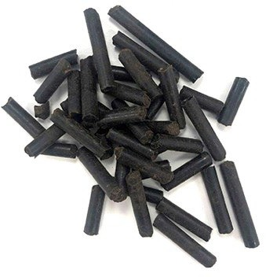
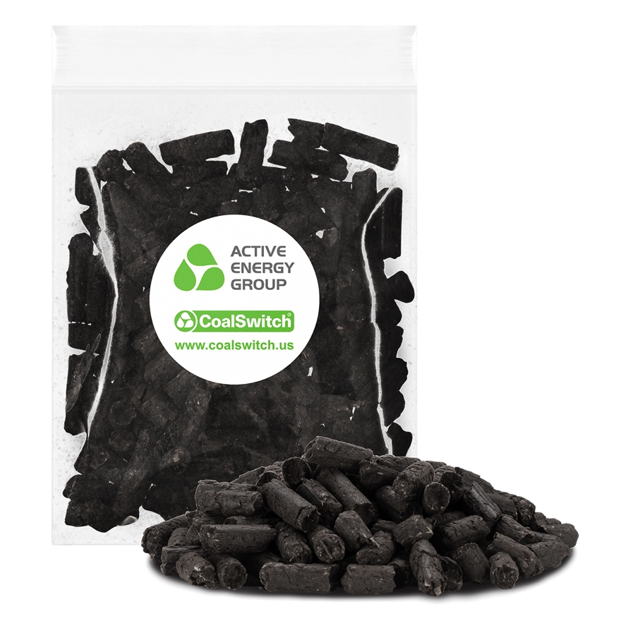
The ‘Next Generation’ biomass pellet
More sustainable
Made from low-cost wood derived biocarbon from forestry & lumber operations
Reduces life-cycle emissions of coal burning by 99%
Double-digit reductions in NOx and SOx
Completely compatible
Can be co-fired at any blend rate with traditional coal
Handles like coal - transported, stored & ground in existing equipment
Demonstrated performance without fouling
Upends traditional cost model
Parity with coal on a Total Cost of Ownership model
No CapEx costs for compliance
Reduced need for offsets or penalty payments
The first premium pellet that can be blended with coal as a better
biomass solution than white pellets with our increased carbon density
Samples March 2023
Corporate Presentation | 31st March 2023
P4

Slide 5


AEG only utilizes FSC-certified forestry and lumbermill residuals
Where do we get our feedstock?
Forestry economics support sustainable sourcing
Cutting down trees purely for biomass is not economic nor sustainable
Commercial forest management is well regulated and controlled
Sawlogs are the primary economic driver for commercial forestry
Saw timber drive landowner harvest and planting decisions
We focus on the residuals, reducing waste, lowering carbon intensity score and driving additional revenues
Biomass generation should use all low-grade residuals
Forest sourced thinnings, branches, tops and other
low-grade wood
Sawdust and chips from wood processing plants
Branches and tops
Low grade wood
Low-value residual
Used in biomass
Forestry
Residuals
Small dimension
Low grade wood
Low-value residual
Used in biomass
Large dimension
Utilisation of sawdust and
all low value wood waste
from wood processing
Lumbermill
Residuals
Sustainability - the vital component in future biomass production
Corporate Presentation | 31st March 2023
P5

Slide 6




CoalSwitch® Immediate impact as a drop-in replacement fuel
AEG has established an active test program to co-fire coal and CoalSwitch®
Proven - CoalSwitch® can be co-fired with immediate environmental and emissions benefits
CoalSwitch® can be handled in power generation facilities with limited to zero CapEx required for reconfiguration
CoalSwitch® provides opportunity to extend life of current coal plants and meet increasing and immediate environmental regulations.
 | PERFORMANCE IMPACT OF CO-FIRING (75% COAL* / 25% COALSWITCH® blend)
Calorific Value: (BTU/lb) | Achieves 93% normal heating values
ASH CONTENT %: | Significant reduction of ash deposits - up to 77%
Grindability – use on bowl mill facilities | FULLY TESTED No degradation in bowl mill performance - lower energy consumption use
SOx / NOx Emissions | DRASTIC REDUCTIONS in both Sulfur Dioxide and Nitrogen Oxide emissions
Emissions | 18% Improvement in emissions values
STEP Program Partners/AEG Test Data:
Source: AEG test data 2021/2022. * Utah Bituminious Coal.
Corporate Presentation | 31st March 2023
P6

Slide 7

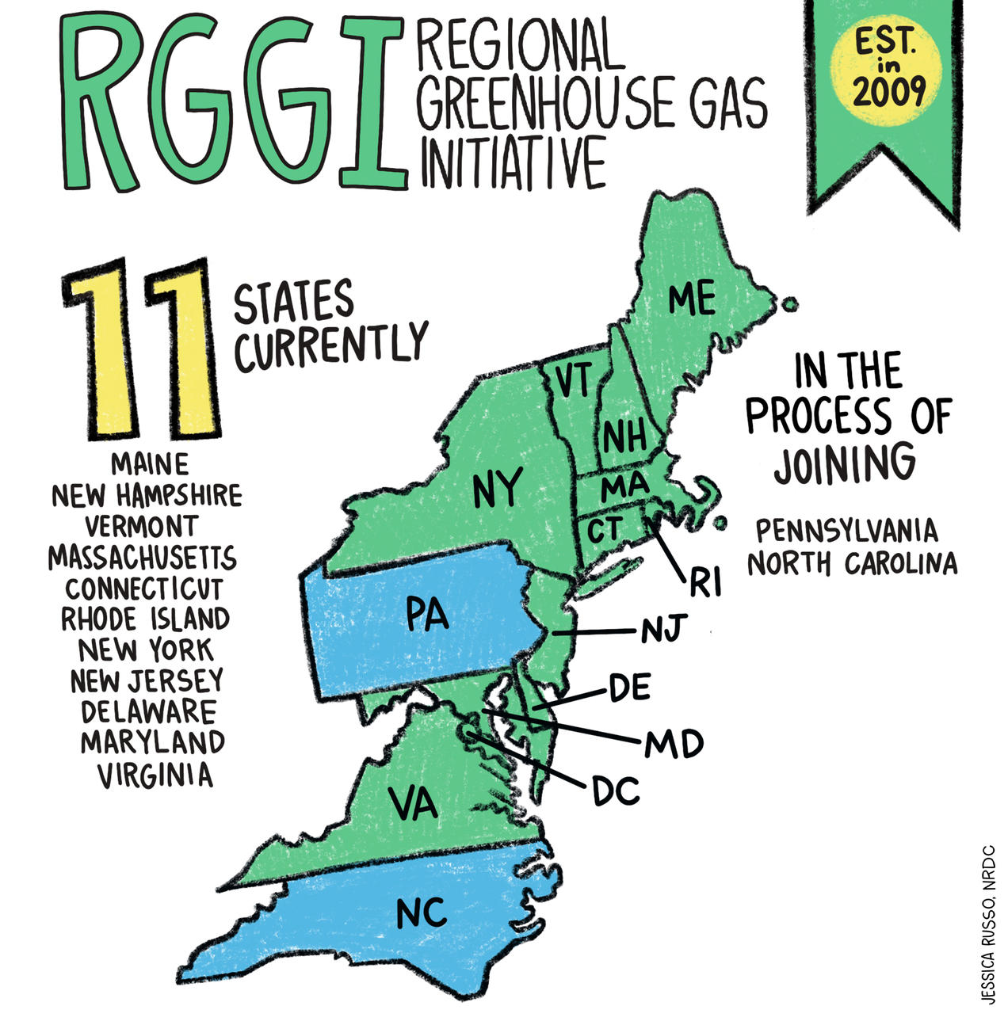

CoalSwitch® = eligibility for carbon credits and other programs
Compliance programs
Utilities and power providers that substitute CoalSwitch® for coal can both meet requirements for emissions reduction AND qualify for Renewable Energy Credits.
Hard to decarbonize industries that substitute CoalSwitch® for coal can reduce emissions to meet requirements as well as reduce spending on costly offset credits on markets like the VCM or RGGI.
CoalSwitch® can turn a pure cost (feedstock) into either a cost-neutral or profitable proposition while also achieving your ESG corporate goals.
Renewable Portfolio Standard (RPS) Programs
Compliance Carbon Programs
Voluntary Carbon
Programs
Voluntary REC
Programs
US States with active RPS programs and targets
Source: Berkeley Lab, Karbone
Corporate Presentation | 31st March 2023
P7

Slide 8
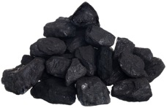
CoalSwitch® Wins on Total Cost of Operations
Fossil Fuels
Cost
Vs
Base Cost
Additional Costs
Base Cost
Credits & Savings
Lower cost
per ton
Compliance
Pollution penalties
Carbon offset purchases
Higher initial cost per ton
Reduced cost of compliance technology
Reduced cost for pollution penalty
Reduced spend on carbon offsets
Income from RECs
CoalSwitch® flips the current model for coal power generation on its head.
On a total cost of operations, CoalSwitch® costs the same or potentially less than coal.
Corporate Presentation | 31st March 2023
P8

Slide 9
A new economic model for biomass fuel
50% Blend *
RGGI + RECs = Revenue
New Hampshire
REC $/MWh | $35.13
% Emission reduction | 0.90
% Biomass Blend | 0.50
Without CoalSwitch®:
Coal CO2 Short Tons/MWh | 1.1282
RGGI Carbon Spot Cost/MWh | $12.40
Total Cost for Emissions/MWh | $13.99
With 50% CoalSwitch® *:
REC Credits/MWh | $17.57
Avoided cost of compliance/MWh | $6.30
Economic Advantage of CoalSwitch® $/MWh | $23.87
Model reflects an RGGI compliant facility adopting a 50% CoalSwitch® blend* with Coal
RGGI spot pricing @ $12.40/MWh and REC Price $34.00/MWh
CoalSwitch® turns compliance from a cost center into a revenue center
*Assumes coal/50% CoalSwitch® blend
Now is the time to CoalSwitch®
Corporate Presentation | 31st March 2023
P9

Slide 10
Economic impact on 100MWh RGGI facility
50% Blend *
Potential Cost Reductions + Incentives
Plant and Input Calculations
Annual MWh Generated | 438,000
Tons of Coal Required | 120,450
Tons of CoalSwitch® Required | 120,450
RGGI Calculations
Tons of CO2 Avoided | 251,259
CO2 Emissions Cost Saved/Ton of CoalSwitch® | $25.87
Cost of Emissions Avoided | $3,115,607.88
REC Calculations
MWh/Ton of CoalSwitch® | 1.45
REC Revenue/Ton of CoalSwitch® | $49.45
Total REC Value | $5,956,800.00
Total Avoided RGGI Costs + REC Incentives | $9,072,408
Model reflects a 100 MW RGGI compliant facility adopting a 50% CoalSwitch® blend* with Coal
(365 days / 24 hours per day)
RGGI spot pricing @ $12.40/MWh and REC Price $34.00/MWh
CoalSwitch® generates $9 million
in savings and credits which offset
the higher per-ton cost of CoalSwitch®.
*Assumes coal/50% CoalSwitch® blend
Potential significant cost reductions & incentives
Corporate Presentation | 31st March 2023
P10

Slide 11
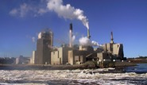
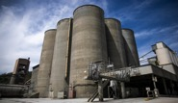
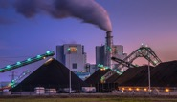
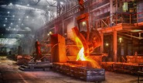
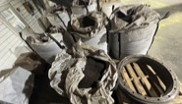
Our Future Markets
How are we marketing CoalSwitch® ?
Pulp & Paper
AEG is in active sales discussions with companies (both large & SME) in each of these sectors.
Established process to deliver smaller quantities at outset, testing in a facility and then leading to long term supply contracts.
Focused on future customers both internationally and establishing use in USA within existing infrastructure
Targeting customers and industries with a corporate commitment for ESG
Identifying customers that would benefit from seamless change from white pellets
to black pellets
Cement
INDUSTRIALS
Power Generation
Steel
HEATING
PELLET MARKET
Retail Sales
Corporate Presentation | 31st March 2023
P11

Slide 12
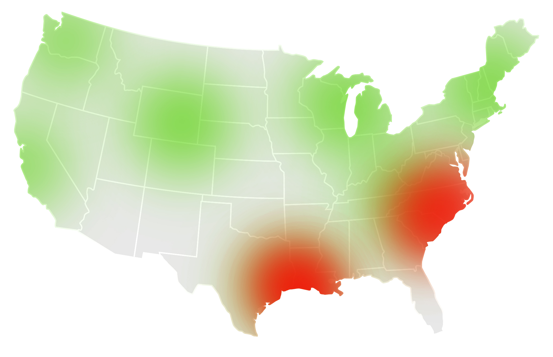
Immediate opportunities for AEG and CoalSwitch®
Ashland
Sales
into Asia
Sales into Europe
Available
Timberstock
Current production
centers for biomass
Sales
into USA
Sourcing of
forestry
Production centers
for biomass
  Breathes life into rural areas previously reliant on the lumber and pulp industry
  New England, Pacific Northwest and Gulf Coast are regions of prime interest for future expansion plans
Corporate Presentation | 31st March 2023
P12

Slide 13


Active Energy Group plc
e: info@aegplc.com
twitter.com/aegplc
www.aegplc.com
www.coalswitch.us

